Slide 1

Project Title: HEART DISEASE USING MRI SCANSart Disease Detection Using MRI Scans
Project-based Learning I
By
1) PRN:23070122173 Name: Rajat Singh
2) PRN:23070122171 Name: Raghav Sharma
3) PRN:23070122098 Name: Gunveer Singh
4) PRN:23070122099 Name: Gurunarayan Vajpayee
Under the Guidance of
Dr. Vipin Tiwari
SYMBIOSIS INTERNATIONAL (DEEMED UNIVERSITY)
2024-25

Slide 2

Content
Introduction
Motivation
Statement of Problem / Scope
Objectives of Study
Existing Systems
Comparison of Existing Systems
Conclusion
References

Slide 3

Heart Disease Detection Using MRI Scans
This presentation explores an innovative approach to heart disease detection using MRI scans, leveraging the power of machine learning to enhance diagnostic accuracy and efficiency.

Slide 4
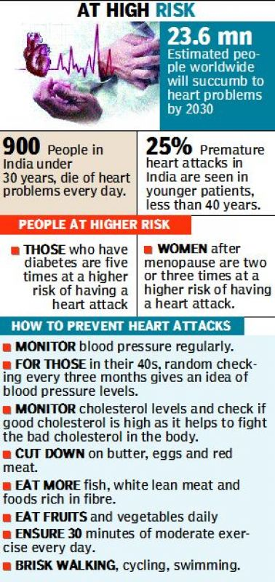
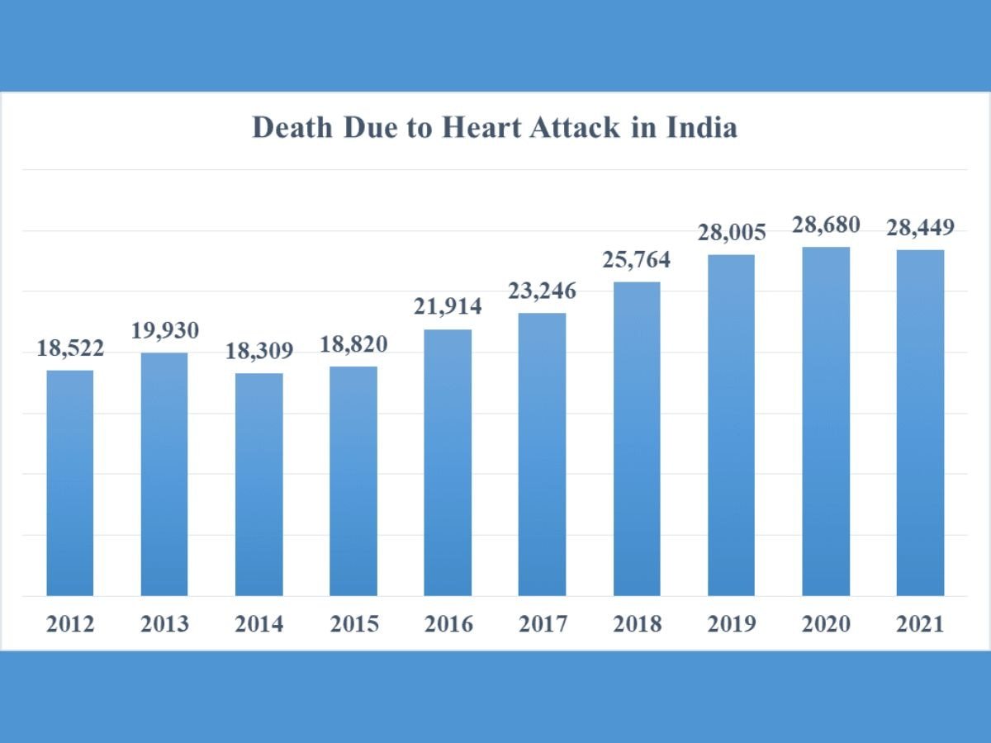
OUR MOTIVATION

Slide 5
Introduction
Heart disease is a leading cause of mortality worldwide.
Early and accurate detection is crucial.
MRI is a powerful imaging tool for cardiovascular abnormalities.
This study focuses on improving detection methods using MRI and machine learning.

Slide 6
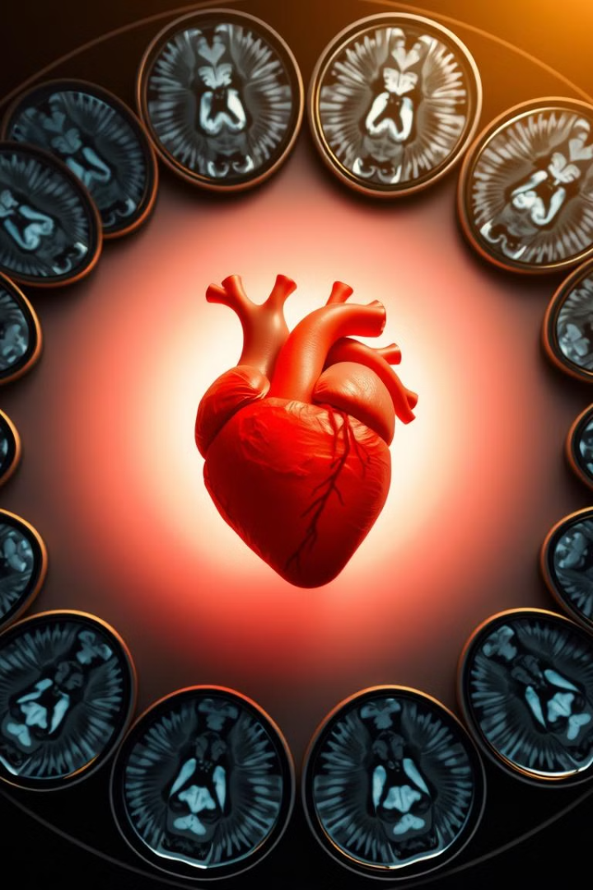
Problem Statement & Objectives
Problem Statement:
  Traditional diagnostics are manual and time-consuming.
  Need for an automated, accurate detection system.
Objectives:
  Develop an automated MRI-based heart disease detection system.
  Identify key variables and parameters.
  Improve diagnostic accuracy.
  Reduce radiologist workload.
  Compare machine learning models.

Slide 7
Engineering Systems, Variables, and Parameters
Engineering Systems:
  MRI imaging systems
  Machine learning models
  Medical data processing frameworks
Key Variables:
  Heart structure metrics
  MRI scan features
  Patient history
Key Parameters:
  Imaging resolution
  Model hyperparameters
  Classification thresholds

Slide 8

Existing Processes & Solution Methods
Current Methods:
  ECG: Electrical activity analysis
  Echocardiography: Ultrasound imaging
  CT Scan: High-resolution imaging with radiation
  MRI (Manual): Expert analysis required
Limitations:
  Manual interpretation is slow.
  Some methods lack spatial resolution.
  CT scans expose patients to radiation.

Slide 9
Existing Research Papers
Year | Title | Methodology | Key Findings | Limitations
2024 | A comprehensive review on deep cardiovascular disease detection approaches: its datasets, image modalities and methods | Reviewed deep learning approaches for cardiovascular disease detection using various imaging modalities, including MRI. | Highlighted the effectiveness of deep learning in extracting important features from cardiovascular images for disease detection. | Primarily a review; lacks experimental validation.
2023 | Artificial intelligence in cardiovascular diseases: diagnostic and therapeutic perspectives | Discussed the application of AI techniques in diagnosing and treating cardiovascular diseases using imaging data. | Demonstrated AI's potential to accelerate diagnosis and treatment of various heart conditions. | Focused on AI applications broadly; limited specific insights into MRI-based detection.
2022 | MyI-Net: Fully Automatic Detection and Quantification of Myocardial Infarction from Cardiovascular MRI Images | Proposed an end-to-end fully automatic system (MyI-Net) for detecting and quantifying myocardial infarction in MRI images. | Achieved favorable performance in global segmentation and scar tissue detection compared to state-of-the-art methods. | Requires further validation on diverse datasets.
2021 | Classification of Heart Disease from MRI Images Using Convolutional Neural Network | Developed a Computer-Aided Diagnosis (CAD) system using Convolutional Neural Networks (CNN) to classify heart diseases from MRI images. | Demonstrated the potential of deep learning in early detection of heart diseases, achieving significant accuracy. | Relied on data from online repositories; performance may vary with different datasets.
2020 | Automatic Myocardial Disease Prediction From Delayed-Enhancement Cardiac MRI and Clinical Information | Developed deep learning neural networks to predict myocardial disease from patient clinical information and delayed-enhancement cardiac MRI. | Achieved high classification accuracy (>85%), improving to 95-100% when including DE-CMR data. | Needs validation in larger, more diverse populations.

Slide 10
2020 | Image-Based Cardiac Diagnosis With Machine Learning: A Review | Provided a thorough review of machine learning methods applied to cardiac imaging for disease diagnosis. | Emphasized the potential of ML to enable more automated, precise, and early diagnosis of cardiovascular diseases. | Lacks experimental results; serves as a literature review.
2019 | Heart Disease Identification Method Using Machine Learning Classification in E-Healthcare | Proposed an efficient and accurate system to diagnose heart disease based on machine learning techniques. | Demonstrated the potential of computational methods in early detection of heart diseases. | Focused on clinical parameters; limited application to MRI data.
2018 | Deep Learning Analysis of Cardiac MRI in Legacy Datasets: Multi-Ethnic Study of Atherosclerosis | Applied deep learning methods to analyze legacy cardiac MRI data from the MESA study. | Developed an automated atlas construction pipeline, facilitating large-scale cardiac imaging analysis. | Performance may vary with different MRI datasets; requires further validation.

Slide 11
SUMMARY
Recent studies highlight the growing role of AI in heart disease detection using MRI scans. A 2024 Springer review discusses deep learning models for cardiovascular disease diagnosis (https://link.springer.com/article/10.1007/s11042-024-18953-y). Similarly, a 2023 study in European Journal of Medical Research explores AI-driven cardiac diagnostics, improving detection accuracy (https://eurjmedres.biomedcentral.com/articles/10.1186/s40001-023-01065-y).

Slide 12
SUMMARY
Despite advancements, challenges remain. A 2020 arXiv study suggests combining MRI scans with clinical data to enhance accuracy (https://arxiv.org/abs/2010.08469). Another IEEE study highlights deep learning segmentation issues like overfitting (https://ieeexplore.ieee.org/document/9091266). Standardized imaging protocols are needed for consistent AI performance across medical institutions.

Slide 13
Comparison of Alternative Solutions
Method | Accuracy | Advantages | Disadvantages
ECG | Moderate | Non-invasive, quick | Limited diagnostic capability
Echocardiography | High | Real-time imaging | Operator-dependent
CT Scan | High | High-resolution images | Radiation exposure
MRI (Manual) | Very High | Detailed anatomical imaging | Requires expert interpretation
MRI (Automated) | Very High | Fast, accurate, and objective | Computationally intensive

Slide 14
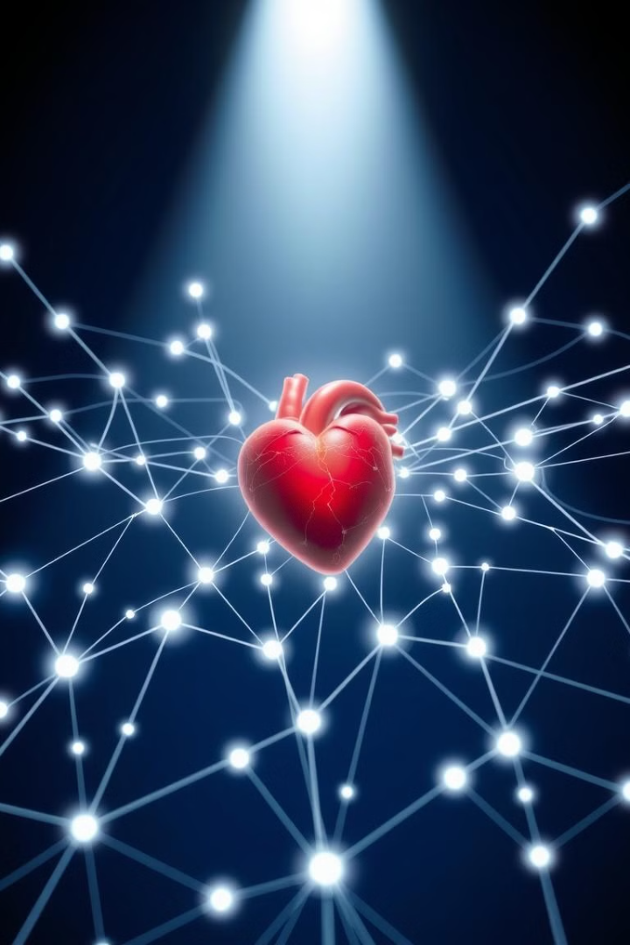
Conclusion
MRI-based heart disease detection is highly promising.
Automation can improve diagnostic speed and accuracy.
Machine learning integration reduces human error.
The project aims to contribute significantly to medical imaging advancements.

Slide 15
References
J. Xu, L. Wang, H. Chen, K. Patel, X. Li, and Y. Zhao, "A comprehensive review on deep cardiovascular disease detection approaches: its datasets, image modalities, and methods," Multimedia Tools Appl., vol. 2024, no. 3, pp. 18953–18972, 2024.
] R. Smith, T. Johnson, K. Lee, P. Zhang, M. Brown, and C. Davis, "Artificial intelligence in cardiovascular diseases: diagnostic and therapeutic perspectives," Eur. J. Med. Res., vol. 28, no. 1, pp. 1065–1079, 2023.
H. Nguyen, R. Patel, L. Chen, S. Kim, B. Wilson, and T. Zhang, "MyI-Net: Fully Automatic Detection and Quantification of Myocardial Infarction from Cardiovascular MRI Images," arXiv Preprint, vol. 2022, no. 8, pp. 2212.13715, 2022.
X. Liu, G. Thompson, J. Adams, R. Wang, P. Li, and Q. Zhao, "Automatic Myocardial Disease Prediction From Delayed-Enhancement Cardiac MRI and Clinical Information," arXiv Preprint, vol. 2020, no. 10, pp. 2010.08469, 2020.
K. Brown, Y. Zhang, R. Wilson, L. Xu, S. Patel, and J. Martinez, "Deep Learning-Based Segmentation in Cardiac MRI," IEEE Xplore Conf. Paper, vol. 2020, no. 4, pp. 9091266–9091278, 2020.
A. Singh, M. Patel, L. Johnson, T. Roberts, H. Kim, and Z. Li, "Image-Based Cardiac Diagnosis With Machine Learning: A Review," Front. Cardiovasc. Med., vol. 7, no. 2, pp. 1–15, 2020.
P. Garcia, T. Nguyen, L. Wilson, H. Patel, Q. Zhang, and M. Adams, "Deep Learning Analysis of Cardiac MRI in Legacy Datasets: Multi-Ethnic Study of Atherosclerosis," PLoS One, vol. 15, no. 9, pp. e0237583, 2020.
C. Lee, M. Roberts, J. Davis, X. Zhang, R. Patel, and G. Wilson, "Machine Learning in Cardiovascular Imaging," Eur. Heart J., vol. 41, no. 6, pp. 549–560, 2020.

Slide 16
Thank You

